Slide 1
North Western University Course Tittle: Software Development Sessional III Course Code:CSE-3204 1

Slide 2
Welcome to our presentation University Registration Management 2

Slide 3



Team name :NWU_URM
Details Of Team Member
Khandaker Istekharul Haque Jaba Baidya Nishat Yeasmin Arzu
Student ID :20201125010 Student ID:20201132010 Student ID: 20201149010
Department Of CSE Department Of CSE Department Of CSE
North Western University North Western University North Western University
Khulna ,Bangladesh Khulna ,Bangladesh Khulna ,Bangladesh
3

Slide 4
Over View
1.Introduction
2.Objectives
3.Entity Relationship Diagram
4.Site Tree
5. Description
6.Home Page
7. Admin
8.Student
9. Dependencies
10. Conclusion
4

Slide 5
Introduction :
Registration System is easy-to-use web-based software that automates the registration of student’s processes in university/college. It reduces the time it takes to register student’s courses and checking the courses prerequisites, classes and exams scheduling, and average calculations . This software is responsible for entering students’ data and keeping it from the day of admission till the student graduates. So, it processes and maintains student’s data, major, marks, grades, student term summaries, and its historical data, and provides students with the documents needed and certifications and produces different reports for academic and administrative purposes.
5

Slide 6
Objectives :
Application of admission according to qualifications and required specialization.
Standards and requirements of admission in each specialization.
Classification of admitted students in batches which are distributed in accordance to college and specialization.
Installation and verification of admission by giving registration numbers of students either automatically or manually.
Conducting level tests for admitted students to determine their courses.
Extracting reports and statistical charts to determine percentages of admitted and non-admitted students.
6

Slide 7
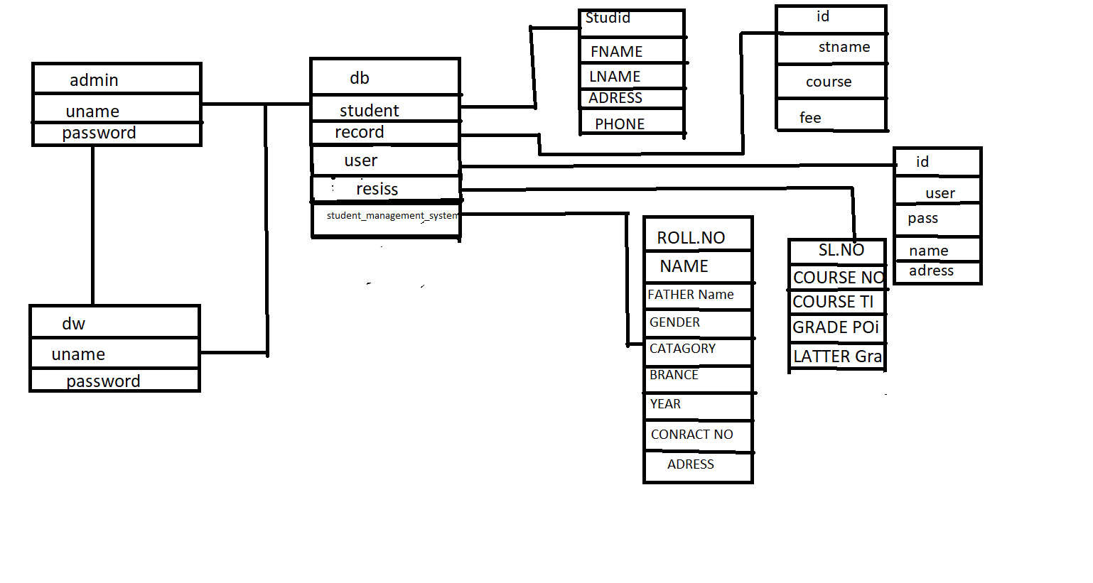
Entity Relationship Diagram
6

Slide 8
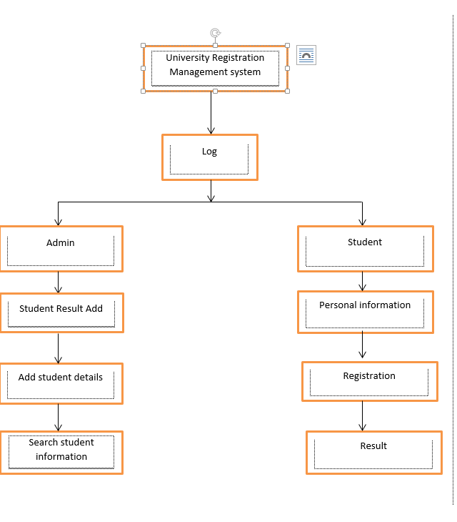
Site tree
There are two characters.
Admin , Student. Each has a
unique view and their own
Feature.
7

Slide 9
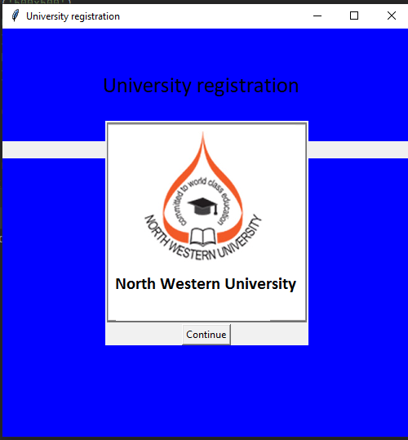
Project View
Home page
8

Slide 10
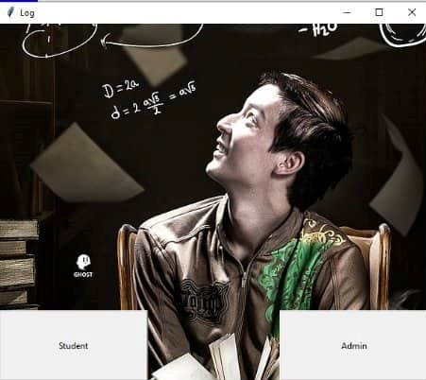
Log in page
9

Slide 11
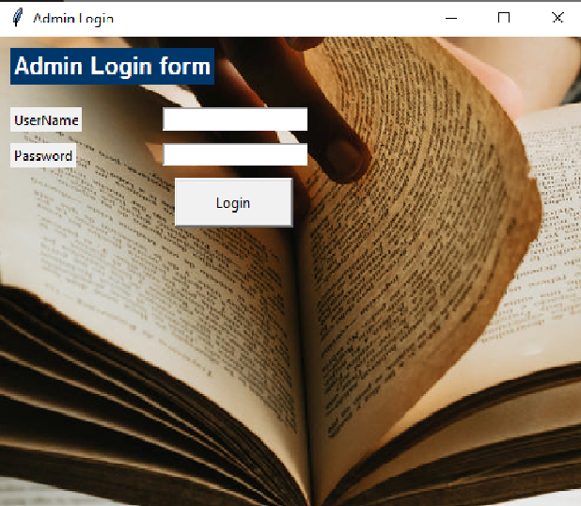
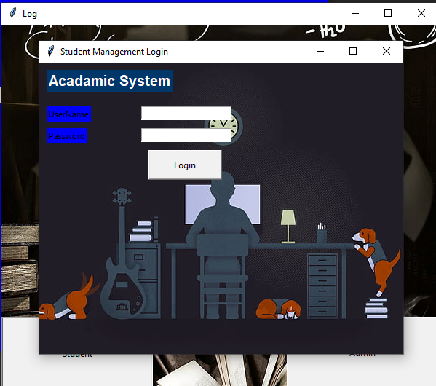
Two characters login
pages
10

Slide 12
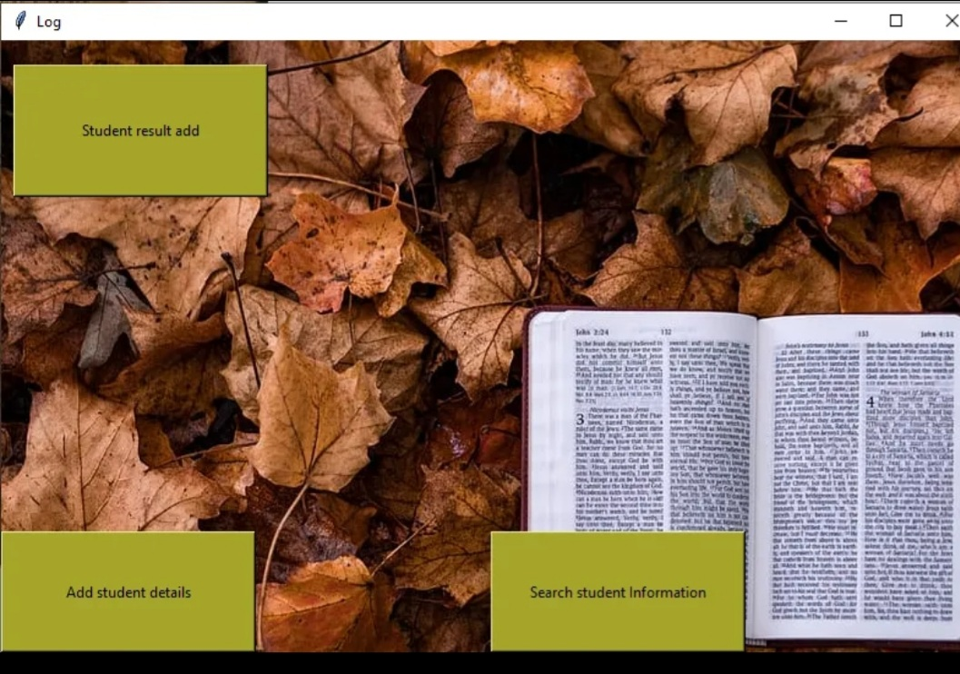
Admin login After Admin log in admin can see those three button and After clicking on those button admin can add student result and details and check information.
11

Slide 13
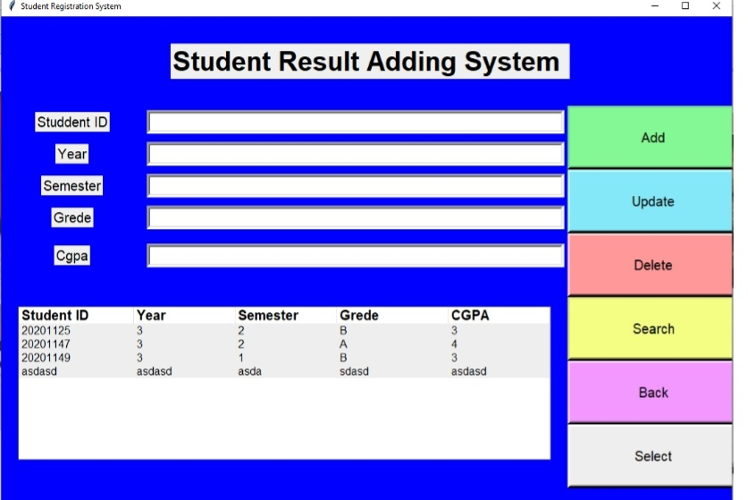
Here Admin can Add, Update, Delete, Search the student details
12

Slide 14
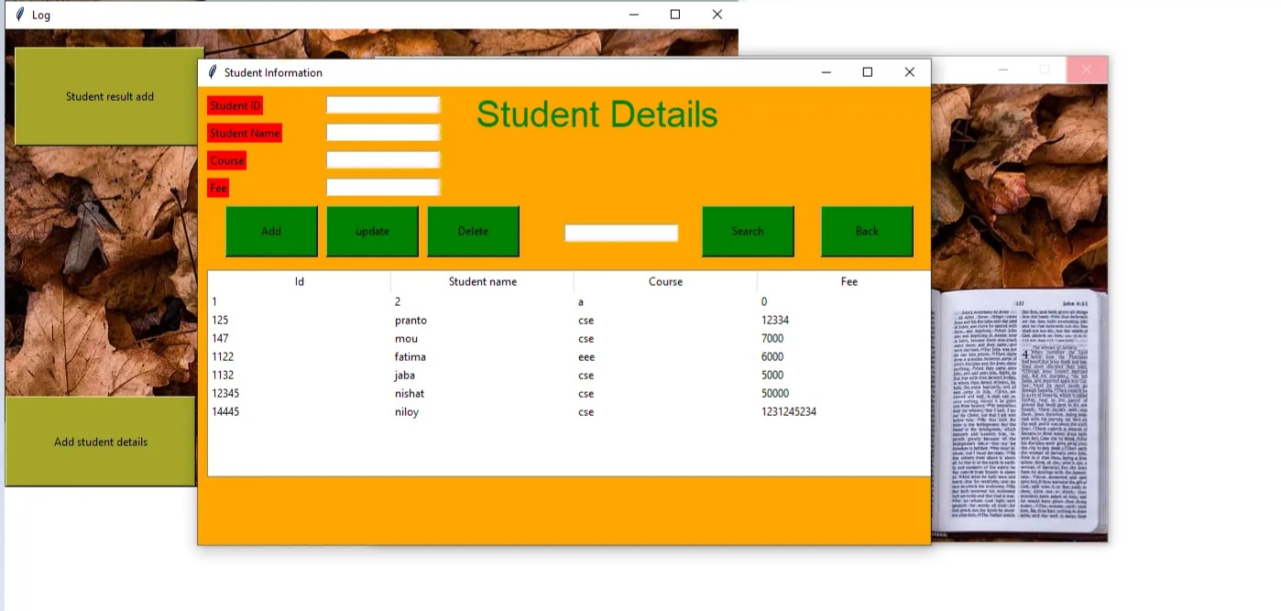
Here where can Admin can where admin can modified student details
13

Slide 15
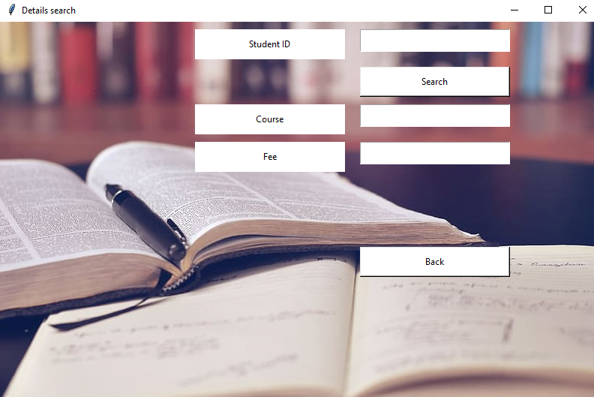
Here where Admin can see student details by searching ID
14

Slide 16
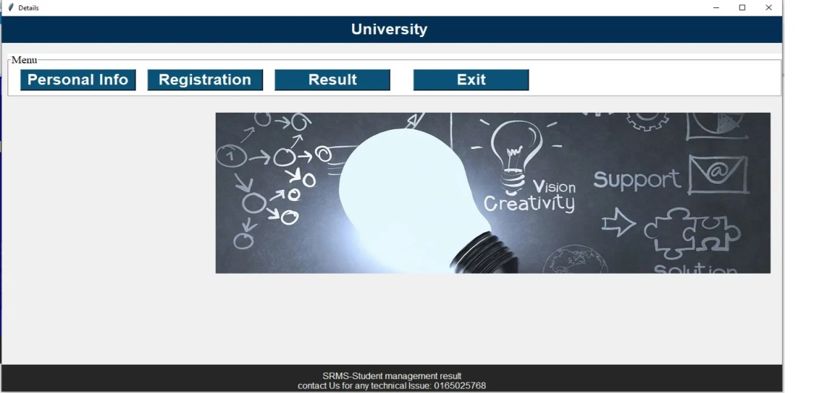
After Student Log in After student log student can see those button .
15

Slide 17
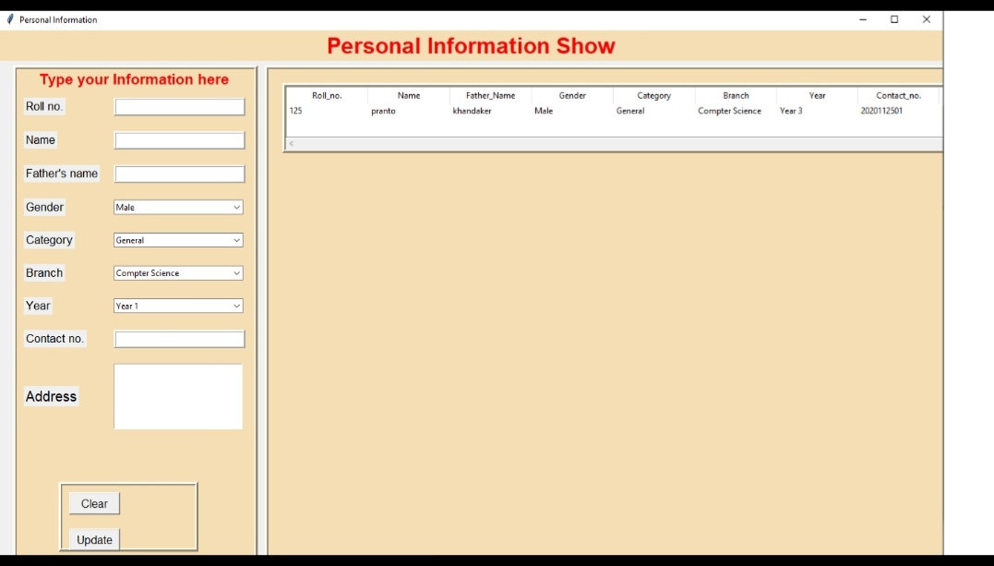
Personal information button
In this page Student can Update their personal details .
16

Slide 18
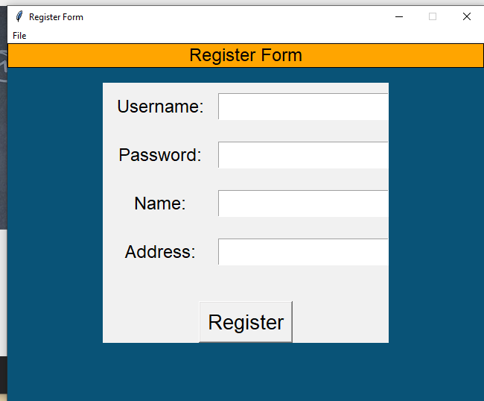
Student registration
Here Student can do their registration and after registration will show successfully register
17

Slide 19
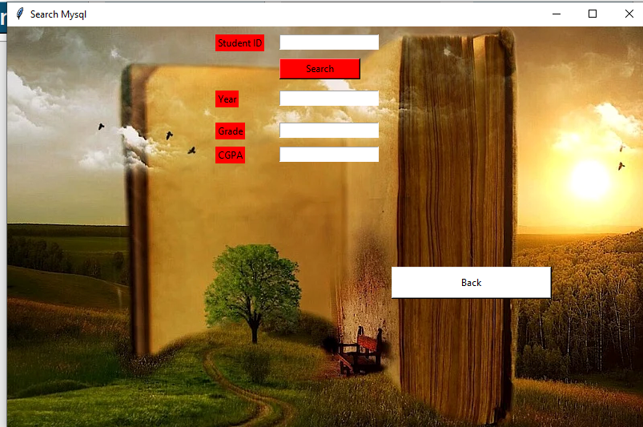
Student result search
After Admin add result student can check their result by searching ID
18

Slide 20
Dependencies:
1. Xampp: The University registration Management systems database is Store in local server. So xampp software is needed to run this project properly.
2. Pycharm: For built this project we use Python language and Python Built in Packages. Install all the Packages which we have use. The name of the packages are given into ReadeMe.txt file. After Install all packages the project will run successfully.
3. Tkinter: We have used Python Tkinter Module for the User Interface. So, you must have to import the Tkinter Module for successfully executing this project.
19

Slide 21
Conclusion
Provides good enough advices
Nice and simple interfaces
It has been a great pleasure to work on this exciting and challenging project. This project proved good for us as it provided practical knowledge of programming in Python.
20

Slide 22
Thank you
21

